Slide 1
Chapter 1
Introduction

Slide 2
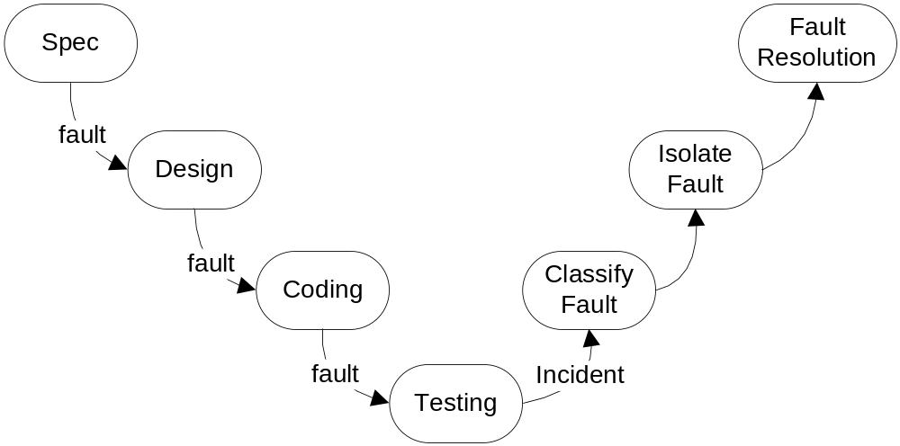
Errors, Faults, Failures and Incidents

Slide 3
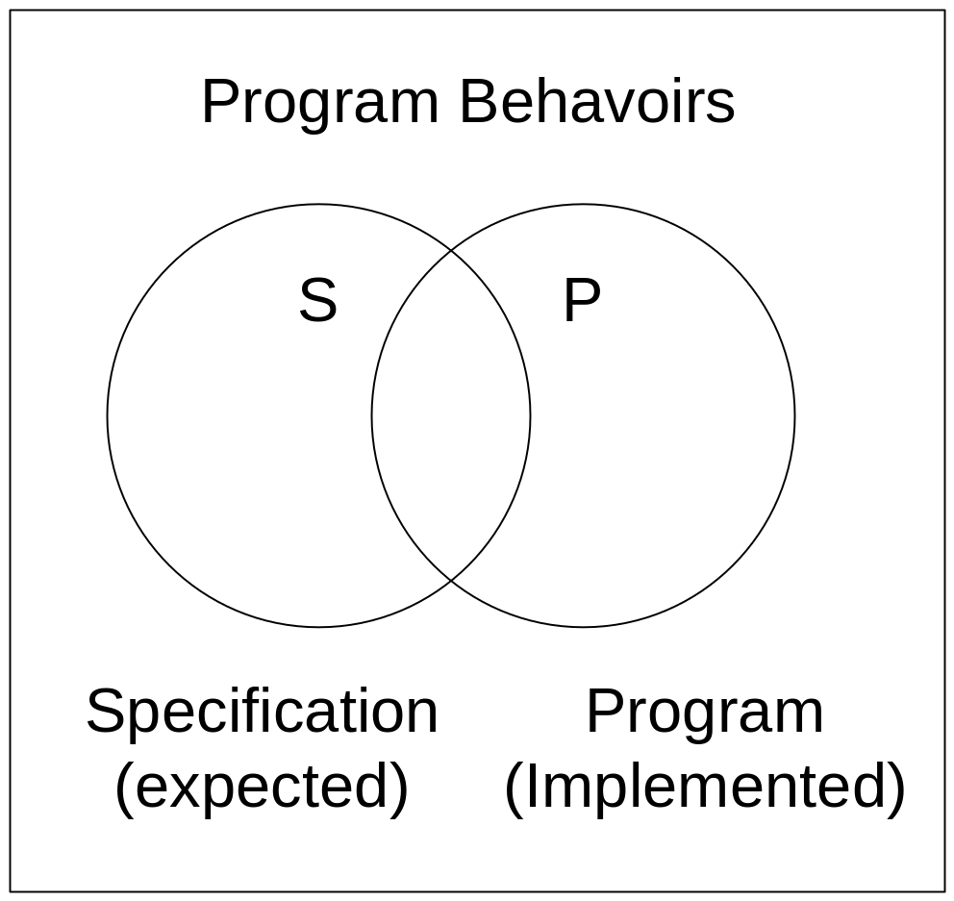
Universe of Discourse—Program Behaviors
Universe of Discourse—Program Behaviors
“Correct” region

Slide 4
About Correctness...
Impossible to demonstrate
A term from “classical” computer science
  “proofs” derived from code
  Not derived from specification
  Can only prove that the code does what it does!
Better viewpoint: a relative term—program P is
correct with respect to specification S.
Bottom Line: do the specification and the program meet the customer/user's expectations?

Slide 5
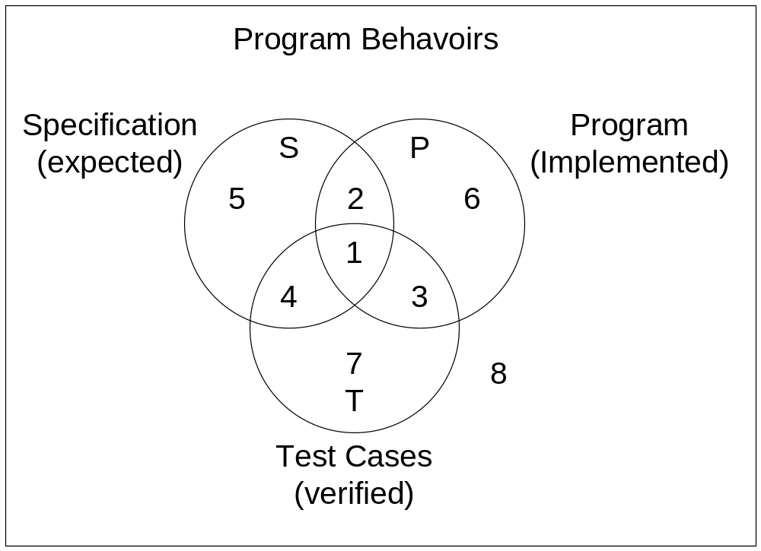
Testing and Program Behaviors
Spec-based testing
Code-based testing

Slide 6
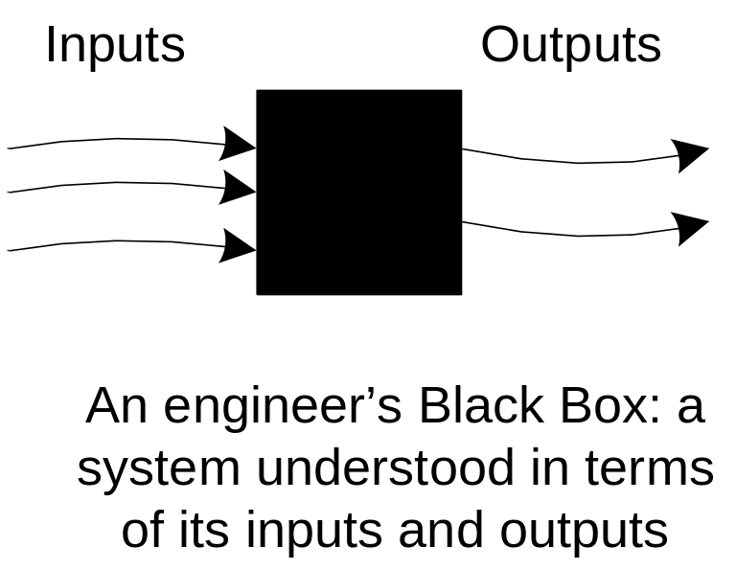
Synonyms—Metaphors gone wild
Specification-based testing
  Functional testing
  Black box testing
Code-based testing
  Structural testing
  White box testing
  Glass box testing
  Clear box testing

Slide 7
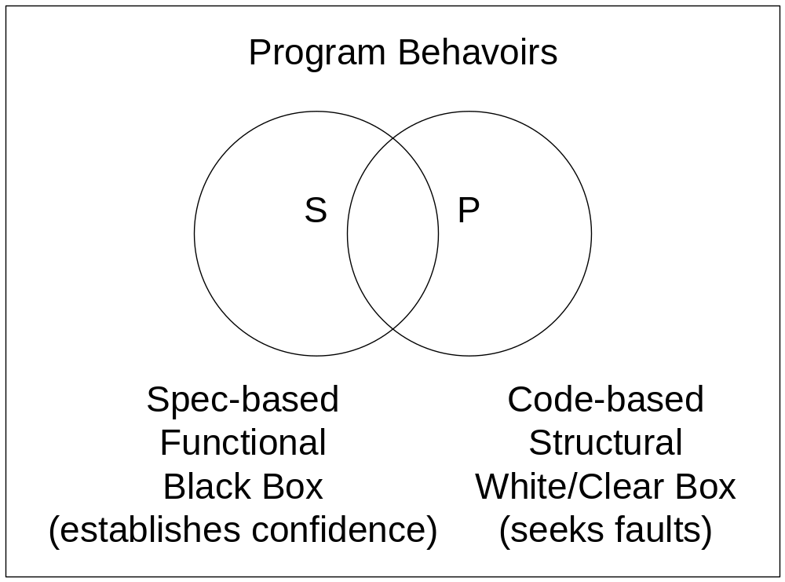

Slide 8
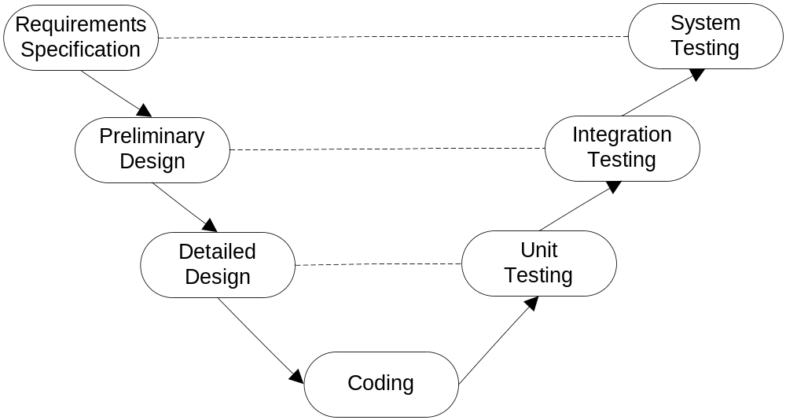
Levels of Testing (as seen in the V-model)

Slide 9
Content of a Test Case
Test case identifier (usually a short name for test management purposes)
Name
Purpose (e.g., a business rule)
Pre-conditions (if any)
Inputs
Expected outputs
Observed outputs
Pass/fail?

Slide 10
Testing as an Experiment
With respect to the Error, Fault, Failure, Incident framework, a test case is an experiment that...
  is designed to anticipate an error
  that is realized as a fault
  that causes a failure
  and is recognized by comparing expected and observed outputs.
In this framework, test cases are intended to reveal incidents.

Slide 11
How Might a Test Case Fail?
False positive?
False negative?
What do these really mean?
Exercise
  Analyze false positive, false negative
  Suggestion: use a decision table with conditions:
    Expected output correct?
    Observed output correct? (potential circularity here)
Compare with common medical usage

